Slide 1
CHILDHOOD RHEUMATIC DISEASES
By Dr. Tejitu U. (MD, Assistant Professor of Pediatrics & Child Health)
11/02/2-25

Slide 2
OUTLINE
Introduction on Rheumatic diseases of childhood
(Connective Tissue Disease, Collagen Vascular Diseases)
Juvenile Idiopathic Arthritis
SLE

Slide 3
Introduction
Are defined by the constellation of results of the physical examination, autoimmune marker and other serologic tests, tissue pathology & imaging.
Defined diagnostic criteria exist for most rheumatic diseases.
Recognition of clinical patterns remains essential for diagnosis because there is no single diagnostic test.
The primary mimics of rheumatic diseases are infection and malignancy but also include metabolic, orthopedic, immune deficiencies, autoinflammatory diseases & chronic pain conditions.
Exclusion of possible mimicking disorders is essential before initiation of treatment for a presumptive diagnosis, especially corticosteroids.

Slide 4
Symptoms Suggestive of Rheumatic Disease
There are no classic symptoms of a rheumatic disease, but common symptoms include:-
    Joint pain
    Fever
    Fatigue
    Rash.
Presenting signs and symptoms help direct the evaluation and limit unnecessary testing.

Slide 5
Conti…
Arthralgias are common in childhood
Although rheumatic diseases may manifest as arthralgias
  Arthritis is a stronger predictor of the presence of rheumatic disease.
Arthralgias without physical findings for arthritis suggest infection, malignancy, orthopedic conditions.

Slide 6
Conti…
Arthralgia may also be a presenting symptom of pediatric SLE and juvenile idiopathic arthritis (JIA).
Other symptoms more suggestive of arthritis include:-
  Morning stiffness
  Joint swelling
  limited range of motion
  Pain with joint motion
  Gait disturbance
  Fatigue or stiffness after physical inactivity (gelling phenomenon).

Slide 7
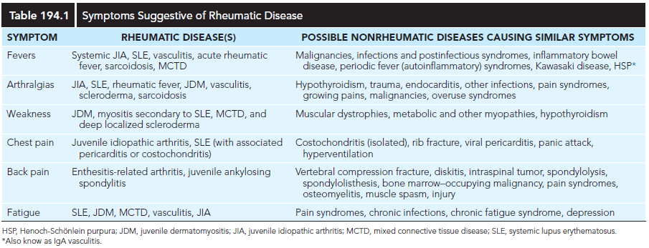

Slide 8
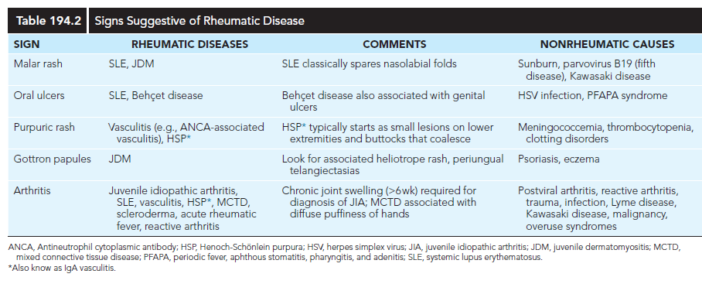

Slide 9
Conti…
Arthritis is defined by the presence of intraarticular swelling or two or more of the following findings on joint examination:
    Pain on motion
    Loss of motion
    Erythema
    heat. (hot to touch)

Slide 10
Conti…
Nonrheumatic causes of arthritis include
  Malignancy
  Septic arthritis
  Lyme disease
  Osteomyelitis
  Viral infections (e.g., rubella, hepatitis B, parvovirus B19, chikungunya)
  Postinfectious etiologies such as Epstein-Barr virus (EBV)
  ARF, and
  Reactive arthritis.
ARF typically involves a migratory (lasting hours to days), painful arthritis.
Pain on palpation of long bones is suggestive of malignancy.

Slide 11
Juvenile idiopathic arthritis (JIA)
JIA is the most common rheumatic disease in children.
It’s one of the more common chronic illnesses of childhood.
JIA represents a heterogeneous group of disorders sharing the clinical manifestation of arthritis.

Slide 12
EPIDEMIOLOGY
  Incidence 0.8-22.6/100,000 /yr
  Prevalence ranges from 7-401/100,000
  These wide ranging reflect
    Population differences
    Environmental exposure
    Immunogenetic susceptibility
    Variations in diagnostic criteria

Slide 13
Conti…
Oligoarthritis is the most common subtype (40–50%), followed by
Polyarthritis (25–30%) and
Systemic JIA (5–15%)
More females than males are affected in both oligoarticular (3:1) and polyarticular (5:1) JIA but are equally affected in systemic JIA (sJIA).

Slide 14
Conti…
The peak age at onset is 2-4 years for oligoarticular disease.
Age of onset has a bimodal distribution in polyarthritis, peaks at 2-4 yrs and 10-14 years.
sJIA occurs throughout childhood, with a peak at 1-5 years.

Slide 15
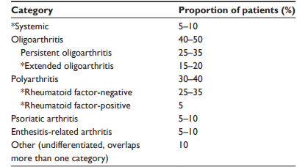
Conti…

Slide 16
Conti…
  F: M
    1:1 in sJIA
    3 : 1 in oligoarticular JIA
    5 : 1 in polyarticular JIA
    1:1 in PA
    1:7 ERA

Slide 17
Conti…
  The peak age at onset
    Oligoarticular:
      2nd and 3rd yrs , less common > 5 yrs and rare after 10 yrs.
    Polyarthritis: Bimodal
      2-4 yr and 10-14 yr
    sJIA : throughout childhood with a peak 1 to 5 yr
    ERA: mean age at onset of 9-12 yr
    PA: onset 7-10yrs

Slide 18
ETIOLOGY
  Not completely understood
  Multifactorial
  Immunogenetic susceptibility
  Both genetic and environmental factors involved
  Concordance rates in monozygotic twins - 25% to 40%

Slide 19
PATHOGENESIS
  JIA is an autoimmune disease
  Alterations of humoral and cell-mediated immunity promote inflammation.
  T lymphocytes release proinflammatory cytokines
  B-cell activation
  Immune complex formation
  Complement activation

Slide 20
Conti…
  Immunologic abnormalities cause
    Inflammatory synovitis
    Vascular endothelial hyperplasia
    Pannus formation (extra growth in joints)
    Erosion of articular cartilage and contiguous bone

Slide 21
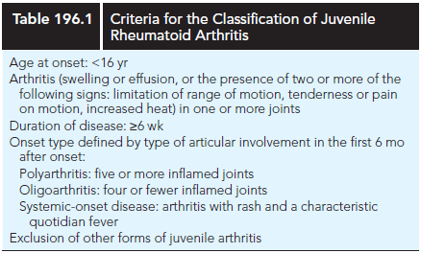

Slide 22
CLINICAL MANIFESTATIONS
Arthritis must be present ≥6 weeks to make a diagnosis of any JIA subtype.
Arthritis is defined by intraarticular swelling or the presence of two or more of the following signs:
  limitation in range of motion (ROM)
  Tenderness or pain on motion, and warmth.
Initial symptoms may be subtle or acute and often include morning stiffness with a limp or gelling after inactivity.
Easy fatigability and poor sleep quality may be present.

Slide 23
Conti…
Involved joints are:-
  Swollen
  Warm to the touch, and
  Uncomfortable on movement or palpation with reduced ROM
  Usually are not erythematous.
Arthritis in large joints, especially knees, initially accelerates linear growth and causes the affected limb to be longer, resulting in a discrepancy in limb lengths.
Continued inflammation stimulates rapid and premature closure of the growth plate, resulting in shortened bones.

Slide 24
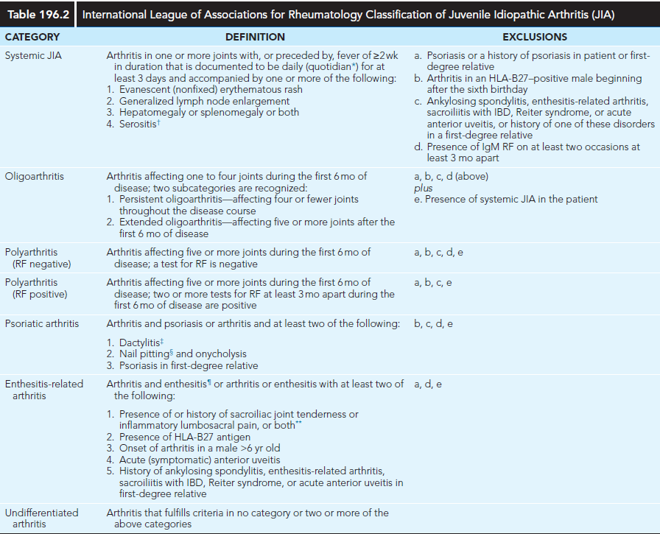
Classification

Slide 25
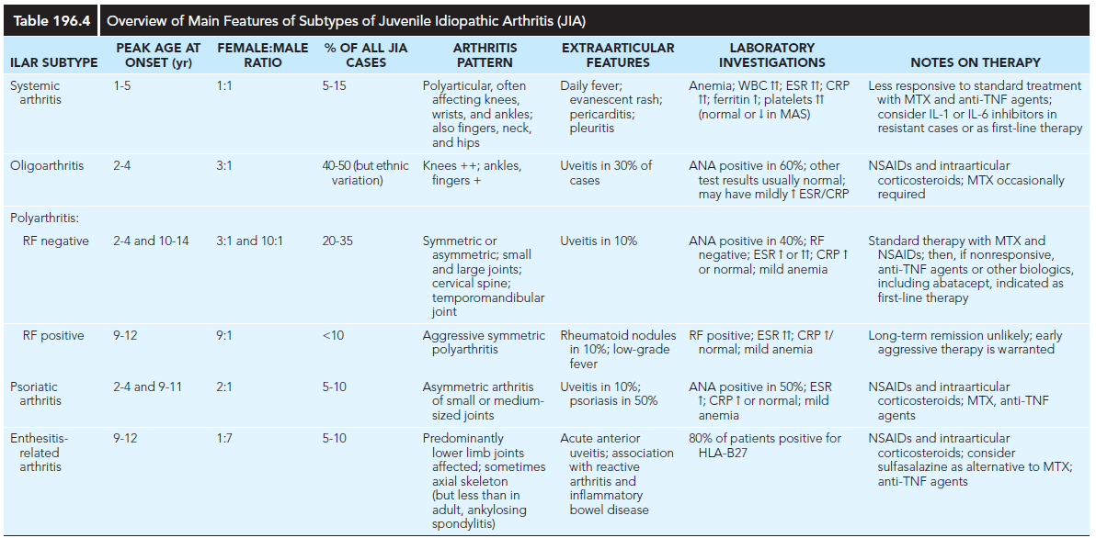

Slide 26
1. Oligoarthritis
≤4 joints within the 1st 6 mo
  A. Persistent oligoarthritis: has a better chance of achieving remission
  B. Extended oligoarthritis: Young age and Females
The most common form of JIA
The disease’s mildest form
It predominantly affects the large joints of the lower extremities, such as the knees and ankles.
Isolated involvement of upper-extremity large joints is less common.

Slide 27
Conti…
Systemic manifestations (other than uveitis) are absent
15% to 20% of oligoarthicular JIA Pts will develop uveitis
Isolated involvement of the hip is rare
Positive ANA increased risk of uveitis
ANA is positive in up to 80%
The presence of a positive antinuclear antibody (ANA) test confers increased risk for asymptomatic anterior uveitis, requiring periodic slit-lamp examination.
ANA positivity may also be correlated with younger age at disease onset, females, asymmetric arthritis, and fewer involved joints over time.

Slide 28
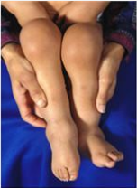
2. Polyarthritis
  ≥5 joints within the first 6 months of being diagnosed with JIA
  Joint involvement is symmetric
  Presence of ANA is unrelated to the severity of arthritis.
  It affects both small and large joints of the hands and feet.
  Usually starts many joints at a time
  More likely to last into adulthood

Slide 29
Conti…
RF–positive
  5 - 10% of JIA
  Older children, onset 10–13 years
  Symmetric
  Rheumatic nodules in 10%
  Large and small joints
  ANA is positive in 75%
  F:m=8-9:1
  More aggresive
B. RF Negative
  More common
  Fewer joints than RF positive
  F > M…. F:M=3:1
  Uveitis = 10%
  Peak 1–3 years and 9–14 years
  ANA positive = 25%
  Symmetric pattern
  Better prognosis

Slide 30
3. SYSTEMIC JIA (sJIA)
Is characterized by arthritis, fever, rash, and prominent visceral involvement, including hepatosplenomegaly, lymphadenopathy & serositis (pericarditis).
The characteristic fever, defined as spiking temperatures to ≥39°C
    Occurs on a daily or twice-daily basis for at least 2 wk
    Rapid return to normal or subnormal temperatures.
    Often present in the evening
    Is frequently accompanied by a characteristic faint, erythematous, macular rash.
    The classic rash is nonpruritic and migratory with lesions lasting <1 hour.

Slide 31
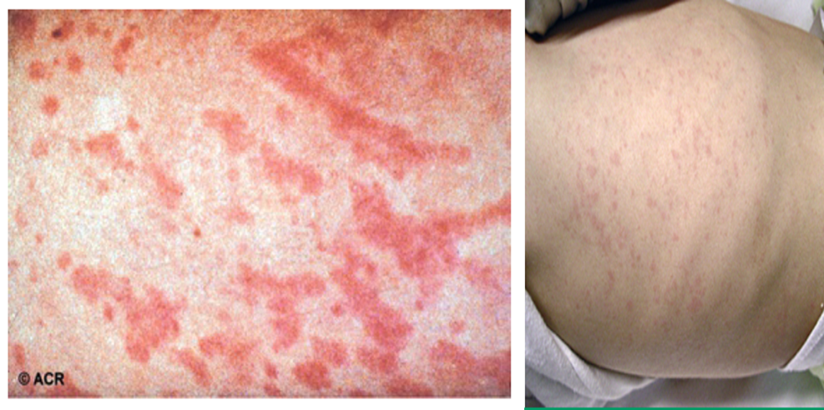
Conti…
  More severe form of JIA.
  Unlike other categories of JIA, sJIA is an autoinflammatory disease.
  sJIA is a diagnosis of exclusion.
  Uniquely characterized with extra-articular symptoms

Slide 32
Conti…
Koebner phenomenon, a cutaneous hypersensitivity in which classic lesions are brought on by superficial trauma, is often present.
Heat can also evoke rash.
Fever, rash, hepatosplenomegaly, and lymphadenopathy are present in >70% of affected children.

Slide 33
LABORATORY
JIA is a clinical diagnosis without any diagnostic laboratory tests.
The meticulous clinical exclusion of other diseases and many mimics is therefore essential.
CBC….↑WBC and ↑ PLTs counts .
Acute phase reactant….↑ ESR and CRP
ANA
  Rarely detectable in oligoarthritis
Antibodies to histones …6% of oligarticular JIA, 12% in uveitis

Slide 34
Conti…
  RF
    5-15% Polyarticular JIA
    Rare in sJIA
    Almost always negative in oligoarthritis
  Anti–cyclic citrullinated peptide antibody
    Rarely been demonstrated in ologoarthritis

Slide 35
Conti…
  sJIA : striking elevations in
    Inflammatory markers
    White blood cell
    Platelet counts
  Hgb (↓) :7-10 g/dl-anemia of chronic disease
  ESR (↑) except in MAS
  ↑ IG levels
  Ferritin typically ↑,markedly ↑ in MAS (>10,000 ng/mL)

Slide 36
Conti…
  Radiographic:
    Soft tissue swelling
    Periarticular osteopenia
    Periosteal new-bone apposition
  MRI is more sensitive than radiography to detect early changes

Slide 37
DDx
  Septic arthritis
  Reactive arthritis
  ALL
  SLE
  Trauma or nonaccidental injury
  Osteomyelitis
  Bone tumours
  IBD
  HSP
  Vasculidites
  Rheumatic fever
  Hypermobility

Slide 38
MANAGEMENT
Multidisciplinary involvement
  Pediatric rheumatologist
  Physiotherapist
  Occupational therapist
  Mental health worker
  Ophthalmologist
  Orthopaedic surgeon.

Slide 39
The goals of treatment
  No cure for JIA
      But possible to control the disease
  Achieve disease remission
  Prevent or halt joint damage
  Foster normal growth and development
  Monitoring for potential medication toxicities

Slide 40
PROGNOSIS
  The course of JIA unpredictable
  Some prognostic generalizations can be made on the basis of disease type and course

Slide 41
  Predictors of severe and persistent disease
Young age at onset
RF seropositivity or rheumatoid nodules
Presence of anti–cyclic citrullinated peptide antibodies
Large numbers of affected joints
Polyarticular distribution of arthritis
Fever lasting >3 mo
Increased inflammatory markers for >6 mo.
Disease involving the hip and hand & wrist
sJIA

Slide 42
Complications
  Short stature
  Uveitis
  Leg-length discrepancy
  Joint contractur
  MAS
  Growth retardation
  Low bone mineral density
  Chronic pain syndromes
  Problems with school attendance and socialization

Slide 43

Systemic Lupus Erythematosus

Slide 44
INTRODUCTION
SLE is a chronic autoimmune disease.
Characterized by:-
    Multisystem inflammation
    Presence of circulating autoantibodies directed against self-antigens.
SLE occurs in both children and adults.

Slide 45
Conti…
Affecting females of reproductive age.
Every organ may be affected, most frequently involved are the skin, joints, kidneys, blood-forming cells, blood vessels, and CNS.
Compared with adults, children and adolescents with SLE have:-
  More severe disease and
  More widespread organ involvement.

Slide 46
Etiology
The pathogenesis of SLE remains largely unknown.
But several factors likely influence risk and severity of disease, including
    Genetics
    Hormonal
    Environmental exposures.

Slide 47
Conti…
A genetic predisposition to SLE is suggested by the association with specific genetic abnormalities, including congenital deficiencies of C1q, C2, and C4, as well as several polymorphisms (e.g., interferon regulatory factor 5, protein tyrosine phosphatase N22), and familial clustering of SLE or other autoimmune disease.
In addition, certain human leukocyte antigen (HLA) types (including HLA-B8, HLA-DR2, and HLA-DR3) occur with increased frequency in patients with SLE.
Patients with SLE often have family members, especially mothers & sisters, with SLE or other autoimmune diseases.

Slide 48
Conti…
SLE preferentially affects females, especially during their reproductive years, it is suspected that hormonal factors are important in pathogenesis.
Of individuals with SLE, 90% of the cases are female.
  Making female sex the strongest risk factor for SLE.
  Estrogens are likely to play a role in SLE.

Slide 49
Conti…
Environmental exposures that may trigger the development of SLE remain
largely unknown.
  Certain viral infections, including Epstein-Barr virus (EBV),may play a role in susceptible individuals.
  Ultraviolet light exposure is known to trigger SLE disease activity.
Environmental influences also may induce epigenetic modifications to DNA, increasing the risk of SLE and drug induced lupus.
Drugs such as procainamide and hydralazine can promote lymphocyte hypomethylation, causing a lupus-like syndrome.

Slide 50
Epidemiology
Prevalence of SLE in children and adolescents (1-6/100,000) is lower than that in adults (20-70/100,000).
Prevalence of SLE is highest among blacks, Asians, Hispanics, Native Americans, and Pacific Islanders for both adult and pediatric populations.
SLE predominantly affects females, with reported of:-
    2- 5 : 1 ratio before puberty.
    9 : 1 ratio during reproductive years.
    Return to near prepubertal ratios in the postmenopausal period.

Slide 51
Conti…
Childhood SLE is rare before 5 yr of age.
Usually diagnosed in adolescence, with a median age of 11-12 yr.
Up to 20% of all individuals with SLE are diagnosed before age 16 yr.
Define pediatric-onset lupus as onset of symptoms before age 16, 18 yrs

Slide 52
Pathology
Histologic features most suggestive of SLE include findings in the kidney & skin.
Renal manifestations of SLE are classified histologically according to the criteria of the International Society of Nephrology (ISN).
Renal biopsies are helpful to establish the diagnosis of SLE & to stage disease.
Immune complexes are typically found with “full house” deposition of immunoglobulin and complement.

Slide 53
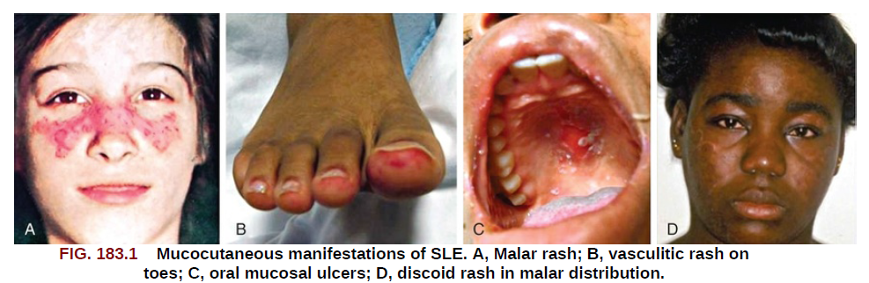
Conti…
The characteristic discoid rash is characterized on biopsy by hyperkeratosis, follicular plugging, and infiltration of mononuclear cells into the dermal-epidermal junction (DEJ).
The histopathology of photosensitive rashes can be nonspecific, but immunofluorescence examination of both affected and nonaffected skin may reveal deposition of immune complexes within the DEJ.
This finding is called the lupus band test , which is specific for SLE.

Slide 54
Pathogenesis
A hallmark of SLE is the generation of autoantibodies directed against self antigens, particularly nucleic acids.
These intracellular antigens are expressed everywhere but are usually inaccessible and cloistered within the cell.
During cell necrosis or apoptosis, the antigens are released.
SLE skin cells are highly susceptible to damage from ultraviolet (UV) light, and the resulting cell death leads to release of cell contents, including nucleic antigens.

Slide 55
Conti…
Individuals with SLE may have greatly increased levels of apoptosis or significantly impaired ability to clear cell debris.
  Causing prolonged exposure to nucleic antigens in the bloodstream and
  Increased opportunity for recognition by immune cells, leading to B-cell stimulation and autoantibody production.
Circulating autoantibodies form immune complexes and deposit in tissues, leading to local complement activation, initiation of a proinflammatory cascade, and, ultimately, tissue damage.

Slide 56
Conti…
Antibodies to double-stranded (ds) DNA can form immune complexes, deposit in glomeruli, and initiate inflammation leading to glomerulonephritis.
However, many individuals with SLE have circulating antibodies to dsDNA but do not have nephritis, suggesting that autoantibodies are not the only pathway leading to end-organ damage in SLE.
Both the innate and the adaptive arms of the immune system have been implicated in the dysregulation of the immune system seen in SLE.
In active SLE, B-cell populations have impaired tolerance and increased autoreactivity, enhancing their ability to produce autoantibodies after exposure to self-antigen.

Slide 57
CLINICAL MANIFESTATIONS
Any organ system can be involved in SLE, so the potential clinical manifestations are myriad.
The presentation of SLE in childhood or adolescence differs somewhat from that seen in adults.
The most common presenting complaints of children with SLE include fever, fatigue, hematologic abnormalities, arthralgia, and arthritis.
Many ϲhildrеn and adolescents have an insidious onset of persistent fever, weight loss, fatigue, and arthralgia, with general deterioration over weeks to months

Slide 58
Conti…
Arthritis is usually present in the first year of diagnosis.
Arthritis may be painful or painless swelling, often with stiffness in the morning, and is usually a symmetric polyarthritis affecting large and small joints.
Tenosynovitis is often present, but joint erosions or other radiographic changes are rare.

Slide 59
Conti…
Renal disease in SLE is often asymptomatic, underscoring the need for careful monitoring of blood pressure and urinalyses.
In adolescents, SLE can present with nephrotic syndrome and/or renal failure, with the predominant symptoms being edema, fatigue, changes in urine color, and nausea/vomiting.
Because SLE symptoms and findings may develop serially over several years and not all be present simultaneously, the diagnosis may require longitudinal follow-up.
The neuropsychiatric complications of SLE may occur with or without apparently active SLE, posing a particularly difficult diagnostic challenge in adolescents, who are already at high risk for mood disorders.

Slide 60
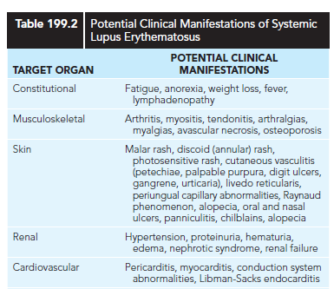

Slide 61
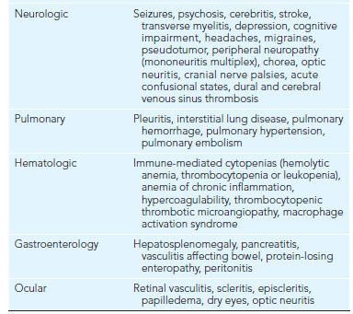

Slide 62
DIAGNOSIS
The diagnosis of SLE requires :-
  Comprehensive clinical and laboratory assessment revealing characteristic multisystem disease and
  Excluding other etiologies, including infection and malignancy.

Slide 63
Conti…
Over the past several decades, SLE classification criteria have undergone serial updates.
Both the American College of Rheumatology (ACR) 1997 Revised Classification Criteria for SLE and the 2012 Systemic Lupus International Collaborating Clinics (SLICC) Classification) are validated in childhood onset SLE populations, with the SLICC Criteria achieving higher sensitivity and the 1997 ACR Criteria achieving better specificity.
In both the 1997 ACR and 2012 SLICC Criteria, a positive antinuclear antibody (ANA) test result is not required for the diagnosis of SLE; however, ANA negative lupus is extremely rare.

Slide 64
Conti…
The ANA test is very sensitive for SLE (95-99%) but is not very specific (∼50%).
The ANA may become positive many years before a diagnosis of SLE is established; however, most asymptomatic ANA-positive patients will never develop SLE.
More recently, the 2019 European League Against Rheumatism/American College of Rheumatology (EULAR/ACR) SLE Classification Criteria provided a different approach by requiring a positive antinuclear antibody (ANA) test result at a titer ≥1:80.
All though the 2019 EULAR/ACR criteria have excellent sensitivity and specificity in the adult SLE population, they are still being validated in pediatric populations.

Slide 65
Conti…
Anti-dsDNA and anti-Smith antibodies are specific for SLE (∼98%) but not as sensitive (40–65%) as the ANA.
Hypocomplementemia was not included in earlier classification criteria, but has been added to the two most recent classification criteria.
The 2012 SLICC Criteria also added as criteria nonscarring alopecia, additional cutaneous and neurologic manifestations, and a positive direct Coombs test in the absence of hemolytic anemia.

Slide 66
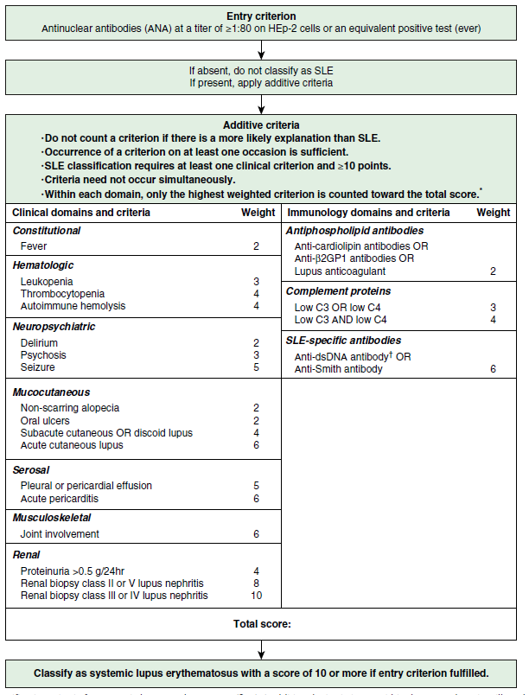
Notes:
Fig. 199.3 Classification criteria for systemic lupus erythematosus (SLE). *Additional criteria items within the same domain will not be counted. †In
an assay with ≥90% specificity against relevant disease controls. (From Aringer M, Costenbader K, Daikh D, et al. 2019 European League Against
Rheumatism/American College of Rheumatology classification criteria for systemic lupus erythematosus. Arthritis Rheum. 2019;71[9]:1400–1412.)

Slide 67
Conti…
For the older ACR criteria, a patient is classified as having ЅԼΕ if 4 or more of the criteria are present, either serially or simultaneously during any interval of observation in the absence of another explanation for the findings.
Similarly, for the SLICC criteria, 4 or more of the criteria are required for classification, but the criteria present must include at least one clinical and one immunologic criterion.
An alternative to the requirement of 4 criteria is positive antinuclear antibodies (ANAs) or anti-double-stranded DNA antibodies (anti-dsDNA) in conjunction with biopsy-proven lսрսѕ ոeрhritis (LN).

Slide 68
Conti…
The 2019 joint EULAR/ACR classification criteria are notably different in that a positive ΑΝΑ is required for further consideration of SԼΕ.
As seen in the table, the criteria are weighted within domains, providing a clinician a sense of the relative likelihood of ЅLE, depending upon the clinical or laboratory feature present within a domain.
A total score of 10 or greater classifies a patient as having SLE.
As an example, a patient with mucocutaneous features might have nonscarring alopecia (score 2), oral ulcers (score 2), subacute cutaneous luрuѕ or discoid lսpuѕ (either scores 4), or acute cutaneous lսpus (ie, malar rash; score 6). Only the highest score is counted within each domain, so a child with a malar rash and an oral ulcer would score 6.

Slide 69
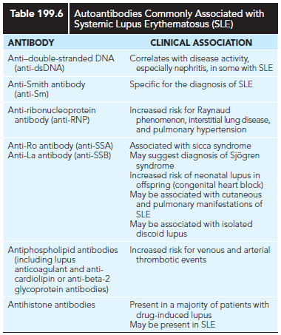

Slide 70
LABORATORY FINDINGS
…
A positive ANA test is present in 95–99% of SLE patients
  ANA-negative lupus is extremely rare.
  ANA has poor specificity (50%) for SLE
  up to 20% of healthy individuals also have a positive ANA test
  ANA titers do not correlate with disease activity
Notes:
Sensitivity is the ability of a test to correctly identify those with the disease (true positive rate)
Specificity is the ability of the test to correctly identify those without the disease (true negative rate).

Slide 71
Conti…
anti-dsDNA levels
  Specific (98%) but not as sensitive (40–65%)
  Correlate with disease activity, particularly in those with significant nephritis
Anti-Smith antibody
  Specific (98%) but not as sensitive (40–65%)
  Does not correlate with disease activity

Slide 72
Conti…
Serum levels of total hemolytic complement (CH50), C3, and C4 are typically decreased in active disease and often improve with treatment.
Hypergammaglobulinemia is a common but nonspecific finding.
Inflammatory markers, particularly the ESR, are often elevated in active disease.
C-reactive protein (CRP) correlates less well with disease activity; significantly elevated CRP values often reflect infection, whereas chronic mild elevation of CRP may indicate increased cardiovascular risk.

Slide 73
Conti…
Antiphospholipid antibodies, which increase clotting risk, can be found in up to 66% of children and adolescents with SLE.
The primary antiphospholipid antibodies are lupus anticoagulant, anticardiolipin, and anti–beta-2 glycoprotein antibodies.
When an arterial or venous clotting event occurs in the presence of an antiphospholipid antibody, antiphospholipid antibody syndrome is diagnosed.
Antiphospholipid antibody syndrome can occur in the context of SLE (secondary) or independent of SLE (primary).
Rarely, antiphospholipid antibodies can result in catastrophic antiphospholipid syndrome, a condition in which clots affect three or more organs/tissues simultaneously; this condition has a very high mortality rate.

Slide 74
Complications
Medication toxicities
cataracts, avascular necrosis, and osteoporosis.
Infections.
Bacterial infection (most common)
CMV and aspergillosis
MAS is a rare but serious complication
Coagulopathy
1)Hypocoagulable states
2) Hypercoagulable states:
Atherosclerosis
Notes:
Ocular toxicity is the greatest concern with hydroxychloroquine
CMV and aspergillosis are particular problems in children who have received immunosuppressive therapy
Broad-spectrum antibiotics
neutropenia and hypocomplementem

Slide 75
Management
The goals of therapy for patients with SLE are to:-
  Ensure long-term survival
  Achieve the lowest possible disease activity
  Prevent organ damage
  Minimize drug toxicity
  Improve quality of life
  Educate patients and their families about their role in disease management

Slide 76
REFERENCE
NELSON TEXT BOOK OF PEDIATRICS 22 EDITION
UPTO DATE 2025

